Slide 1
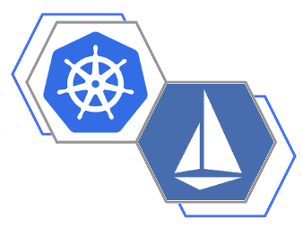
Agenda
Microservices, Kubernetes and Istio
Microservices
Kubernetes
Istio
Service Mesh
Mutual TLS (security)
Routing
Tracing/Metrics
Fault Injection
Lab - Get Kubernetes, Istio, Launch an App
Lab - Routing

Slide 2

Microservices (Day 2 Operations)
Microservices are small nuggets of function, and that sounds like it could be simple, but as complexity grows, successful operations require:
Visibility (Observability)
Monitoring
Metrics
Tracing
Traffic management
Policy Enforcement
Security
Resilience and efficiency
A service mesh (an application network for services) can provide the above.

Slide 3












Kubernetes
Kubernetes provides an infrastructure management service
kubectl, ajax, etc
node
scheduler
devops
API server
node
kubelet
etcd
controller manager
user
service
proxy

Slide 4







Istio Architecture
Control Plane REST API
Pilot
Mixer
Istio-Auth
Config Data to Envoys
Policy Checks, Telemetry
TLS Certs to Envoys
Pod
Pod
Envoy
Envoy
HTTP, gRPC, TCP
with/out TLS
HTTP, gRPC, TCP
with/out TLS
svcA
svcB
Service A
Service B
@rstarmer
© 2017 Kumulus Technologies

Slide 5
Istio
Istio is a service mesh (microservices platform) providing:
Observability
Monitoring
Metrics
Tracing
Traffic Management
Policy
Security
Service Mesh
Kubernetes “native” via platform adapter plugins - also plugs into Mesos, Cloud Foundry, …

Slide 6




Istio - Pilot
Control plane for distributed Envoy instances Configures Istio deployment and pushes out configuration to other system components System of Record for Service Mesh
Routing and resiliency rules
Exposes API for service discovery, load balancing, routing tables
Cloud Foundry
Kubernetes
Mesos
...
Platform Adapter
Pilot
Abstract Model
Rules API
Envoy API
Envoy
Envoy
Envoy

Slide 7




Envoy Proxy
Out of process load balancer:
High performance server/small memory footprint HTTP/2 and GRCP support:
Transparent HTTP/1.1 to HTTP/2 proxy.
APIs for Config Management:
Configuration management via API alone Advanced Load Balancing:
Retries, Circuit Breaking, Health Checks, Rate Limits Observability
L7 visibility, distributed flow tracing
Ingress Envoy
In Istio:
Envoy container is injected with istioctl kube-inject or
kubernetes initializer
Controls pod ingress/egress routing
Config is via API from Pilot
Example Application
Envoy

Slide 8
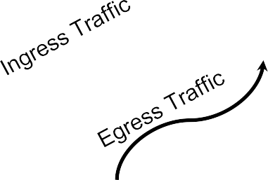





Istio - Mixer
Attribute processor that controls the runtime behavior of mesh-attached services
Envoy generates attributes
I
Mixer then generates calls to backend
infrastructure through adapters
Envoy
Service
Handlers provide integration for 3rd party tools (Prometheus, Grafana, custom tools, …)
All of these “Istio” pieces are expressed as Kubernetes custom resources (CRDs)
Mixer
Infrastructure Backends

Slide 9
Mutual TLS
Available by default, but not required
When enabled, provides automatic service-to-service encryption
Istio has a built in CA that watches for k8s service accounts and creates certificate
keypair secrets in k8s
Secrets are automatically mounted when pod is created Pilot generates appropriate Envoy config and deploys it End-to-end mTLS session generated for each connection.

Slide 10


Ingress/Egress
Istio assumes that all traffic entering/exiting the service mesh transits through
Envoy proxies.
Deploying the Envoy proxy in front of services, operators can conduct A/B testing,
deploy canary services, etc. for user-facing services.
Routing traffic to external web services (e.g video service API) via the sidecar Envoy allows operators to add failure recovery features (e.g.timeouts, retries, circuit breakers, etc.) and obtain detailed metrics on the connections to these services.
Pod
Pod
Pod
Envoy
Ingress Envoy (Ingress controller in k8s)
Envoy
Envoy
svcA
svcB
Service A
Service B

Slide 11










Request Routing - Service Versions
Pod
Pilot
Pod
Rules API
Envoy
Service A
svcA
serviceB.example.com
http:serviceB.example.com
Pod
Pod
Envoy
Envoy
Service B
svcB.0
svcB.1
Version: v1.0, production
Version: v1.1.alpha, staging

Slide 12



Service Observability/Visibility
Monitoring & tracing should not be an afterthought
Ideally a monitoring/tracing system should provide:
Metrics without instrumenting apps
Consistent metrics across fleet
Trace flow of requests across services
Portable across metric backend providers
Istio adapters seamlessly integrate a number of tools:
Prometheus - gathers metrics from Istio Mixer
Grafana - produces dashboards from Prometheus metrics
Service Graph - generates visualizations of dependencies between services.
Zipkin - distributed tracing

Slide 13
Application/service Resilience with Istio
As the number of microservices increase, failure is expected (inevitable?). Fault- tolerance is applications is (should be) a requirement.
Istio provides fault tolerance/resilience with no impact on application code.
Istio provides multiple, built-in features to provide fault tolerance:
Timeouts, Retries with timeout budget, Circuit breakers, Health checks AZ-aware load balancing w/ automatic failover
Control connection pool size and request load Systematic fault injection

Slide 14



















Example Microservice Application with Istio
Running an application with Istio requires no changes to the app itself. We simply need to configure and run the services in an Istio-enabled environment, with Envoy sidecars injected alongside each service.
Envoy
Reviews-v1
Envoy
Reviews-v2
Envoy
Envoy
Envoy
requests
Ingress Envoy
Ratings
Product Page
Reviews-v3
Envoy
Details

Slide 15
Get Started - Deploy Kubernetes
Easiest approach: Launch in the cloud GKE
Azure
AWS with Kops
Or, launch on your own hardware Vagrant/Ansible (kubespray) Kubeadm/Minikube

